Slide 1
Open Source Sex Machines And you
what can you make?
-Paisley-

Slide 2
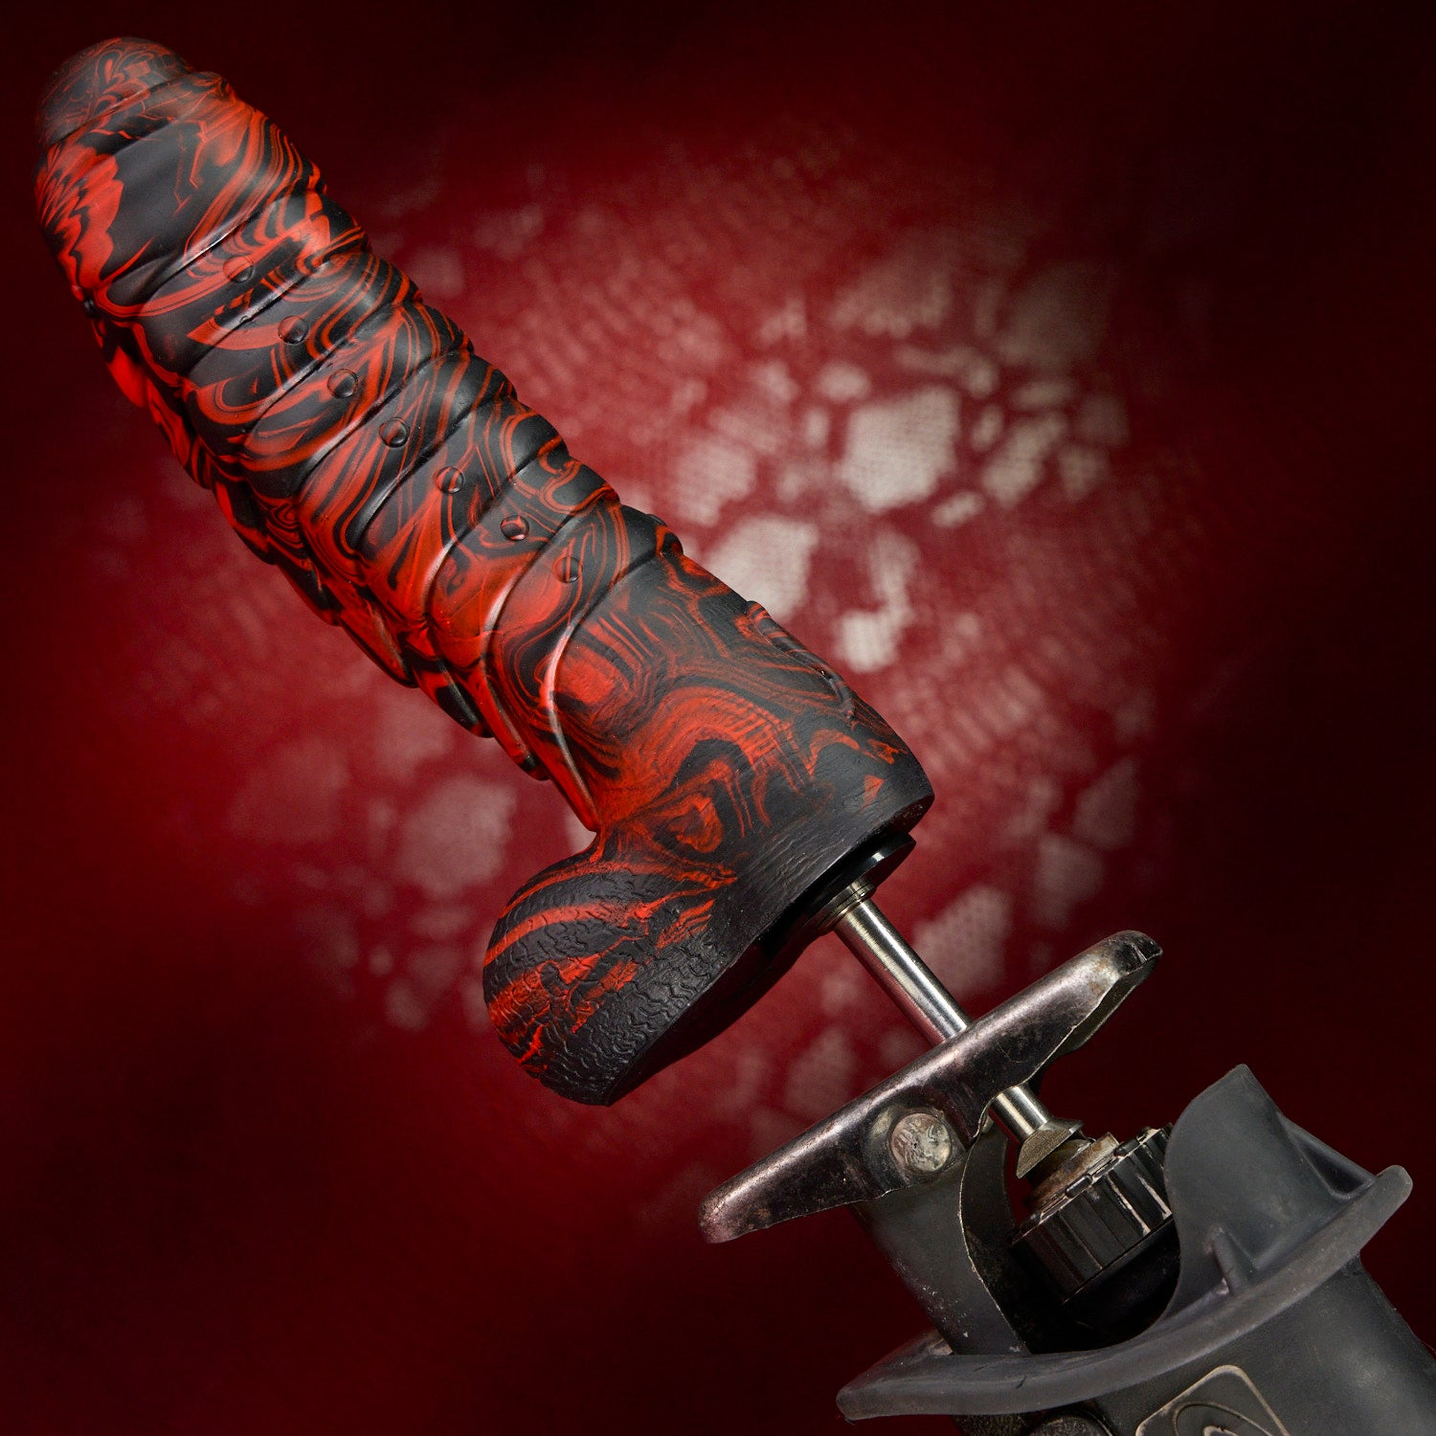
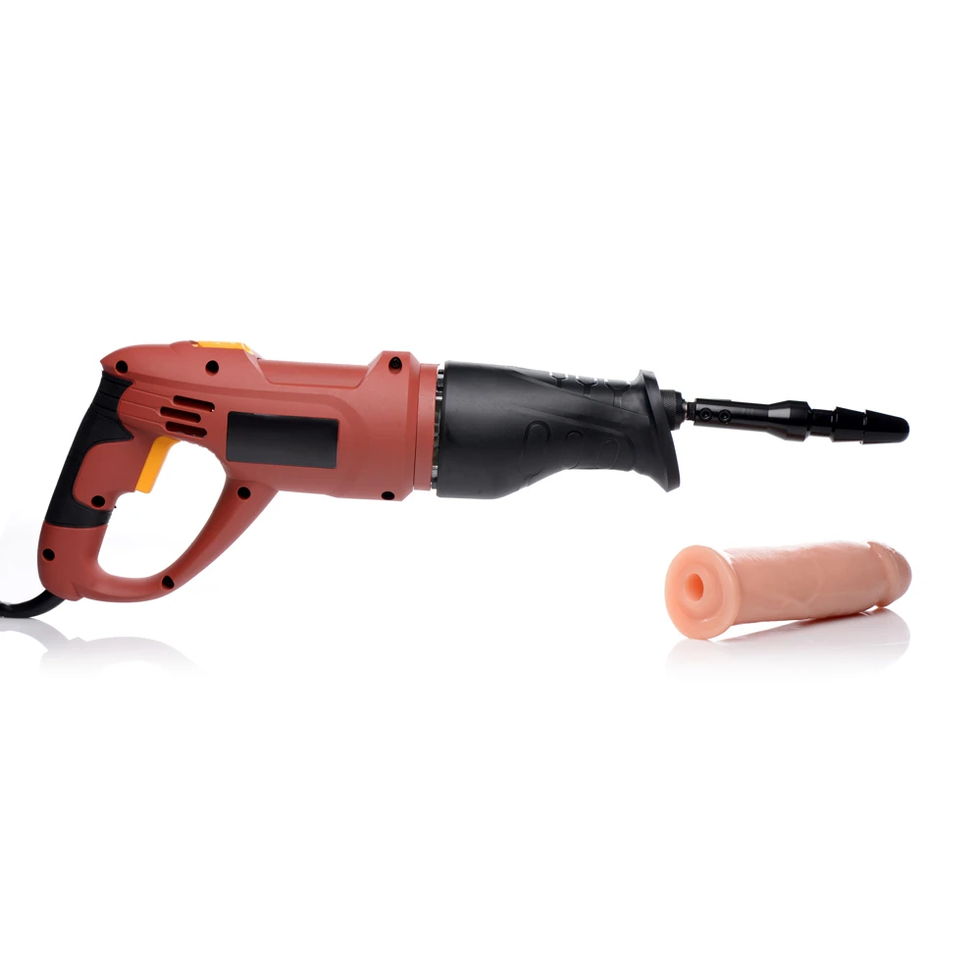

Off the shelf?
Sawzall adapter
  Limited Modification
  Hard to mount
  No stroke length adjustment
  Hold on!
  Still >$100 list price
  Do you own a Sawzall?
Image sources: https://www.kinkstore.com/products/the-fucking-adapter-plus-with-dildo
https://www.dallasnovelty.com/shop/dildos-dongs/fist-hand-foot-misc/xr-brands-lovebotz-the-fuckzall-reciprocating-saw-adapter-aka-fucking-adapter/

Slide 3

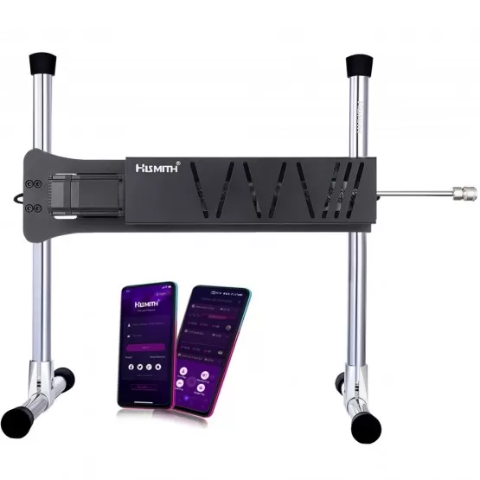
Off the shelf?
Commercial machine – High end
  $1800
  Good looking hardware! Waterproof!
  Still Can only adjust one angle
  Same bad app
Image sources: https://www.hismith.com/en/sex-machines/202-hismith-servok-premium-sex-machine-with-kliclok-system-intelligent-app-control.html

Slide 4
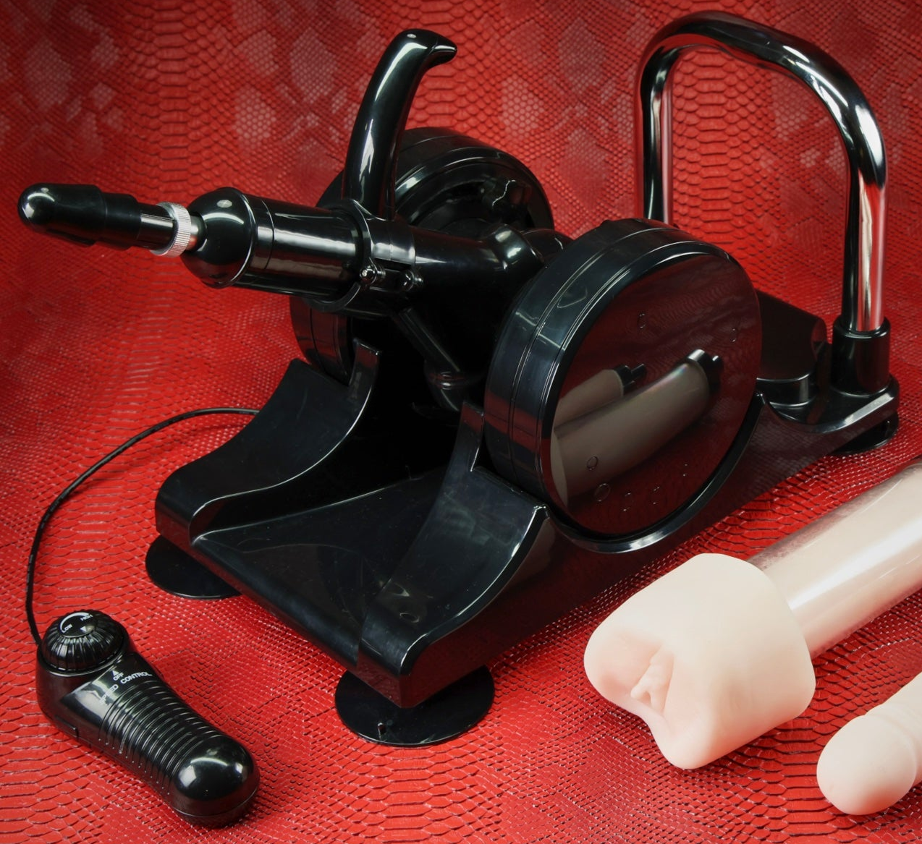

Off the shelf?
Commercial machine – low end
  At least $300
  Fixed stroke length (or stop-and-adjust)
  Can only adjust one angle
  Power limited, probably
  Low program adjustability
    Or an app (2.4 stars on apple, 3.2 on google)
Image sources: https://www.kinkstore.com/products/sex-machine-by-kink
https://www.hismith.com/en/premium-sex-machine/672-hismith-mini-pro-sex-machine-with-kliclok-system-app-controlled-love-machine.html

Slide 5
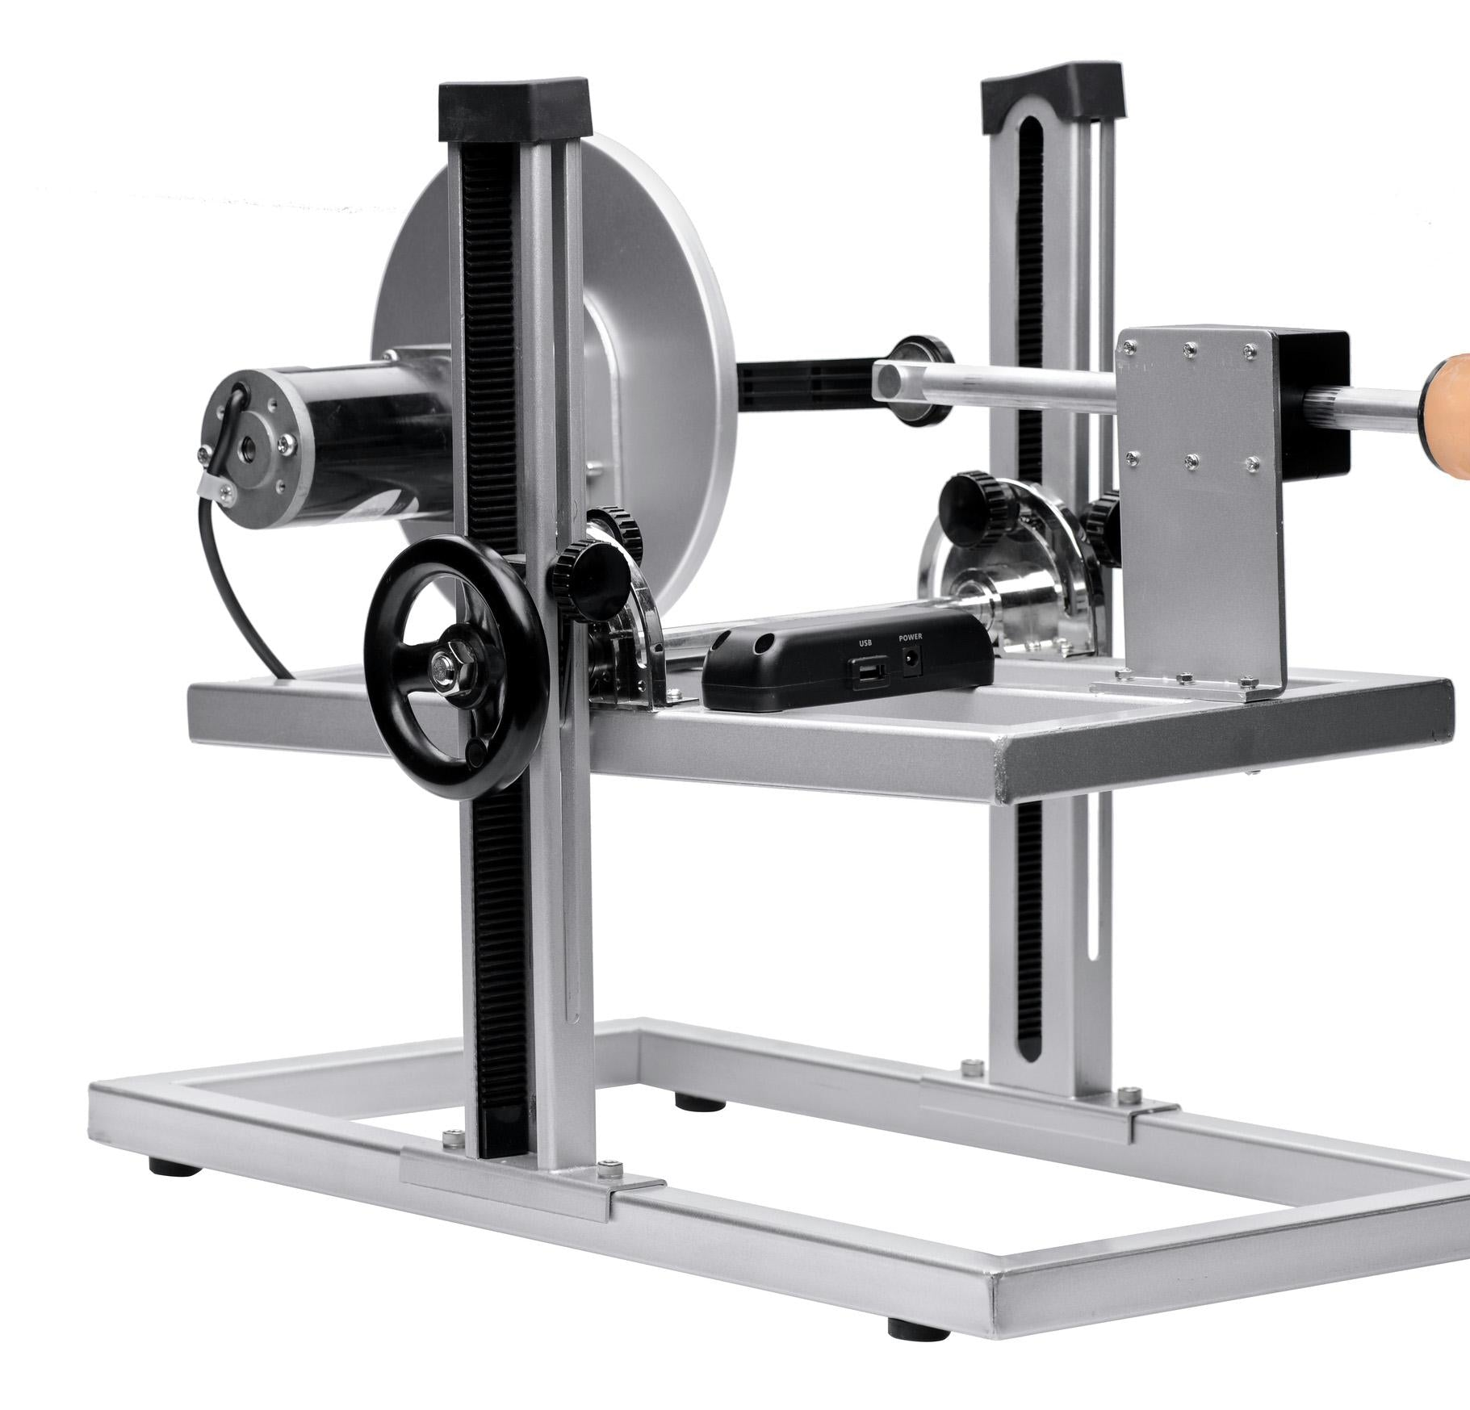
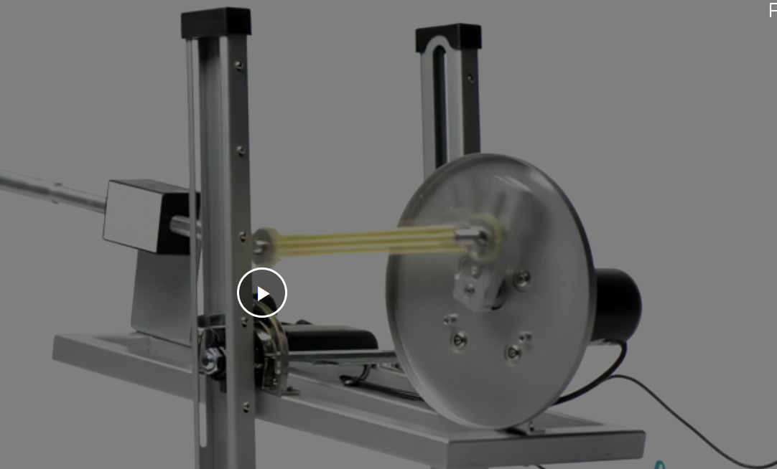
Off the shelf?
Commercial machine – High end
  $800-1000 (source dependent)
  Still can’t adjust stroke length during use
  More adjustable!
  Remote cable is…kinda short?
Image sources: https://www.kinkstore.com/products/maestro-multi-faceted-sex-machine-with-universal-adapter

Slide 6

Off the shelf?
Rambo option for $800
Has a puny little mount
Image sources: https://www.kinkstore.com/products/motorbunny-jack-handheld-thrusting-sex-machine

Slide 7


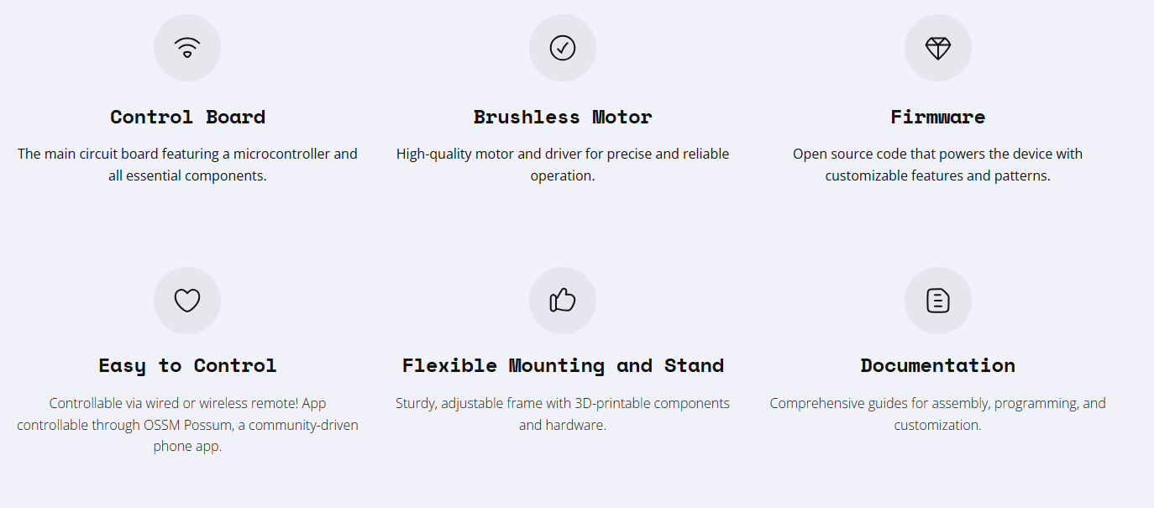
NOW THIS IS A MACHINE
Image sources: https://www.researchanddesire.com/pages/ossm

Slide 8
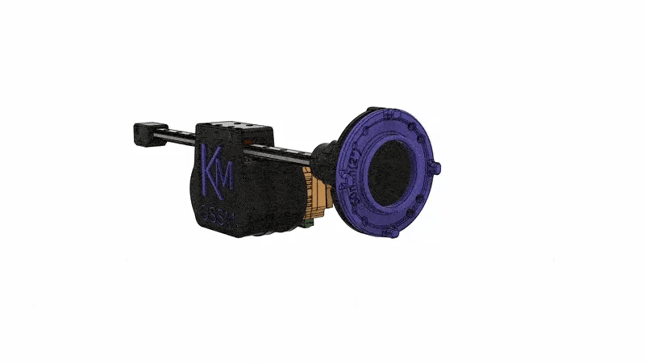
https://www.researchanddesire.com/pages/ossm

Slide 9
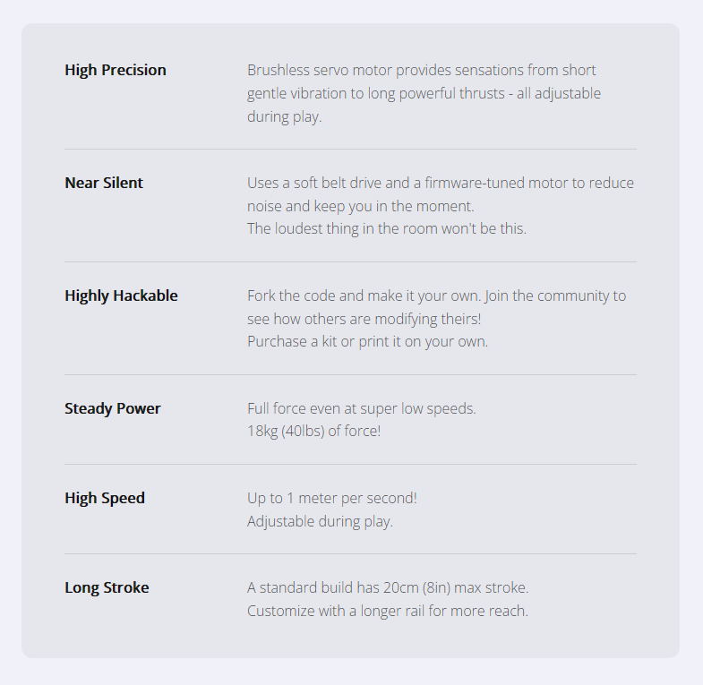
Actual specs, for once
Image sources: https://www.researchanddesire.com/pages/ossm

Slide 10
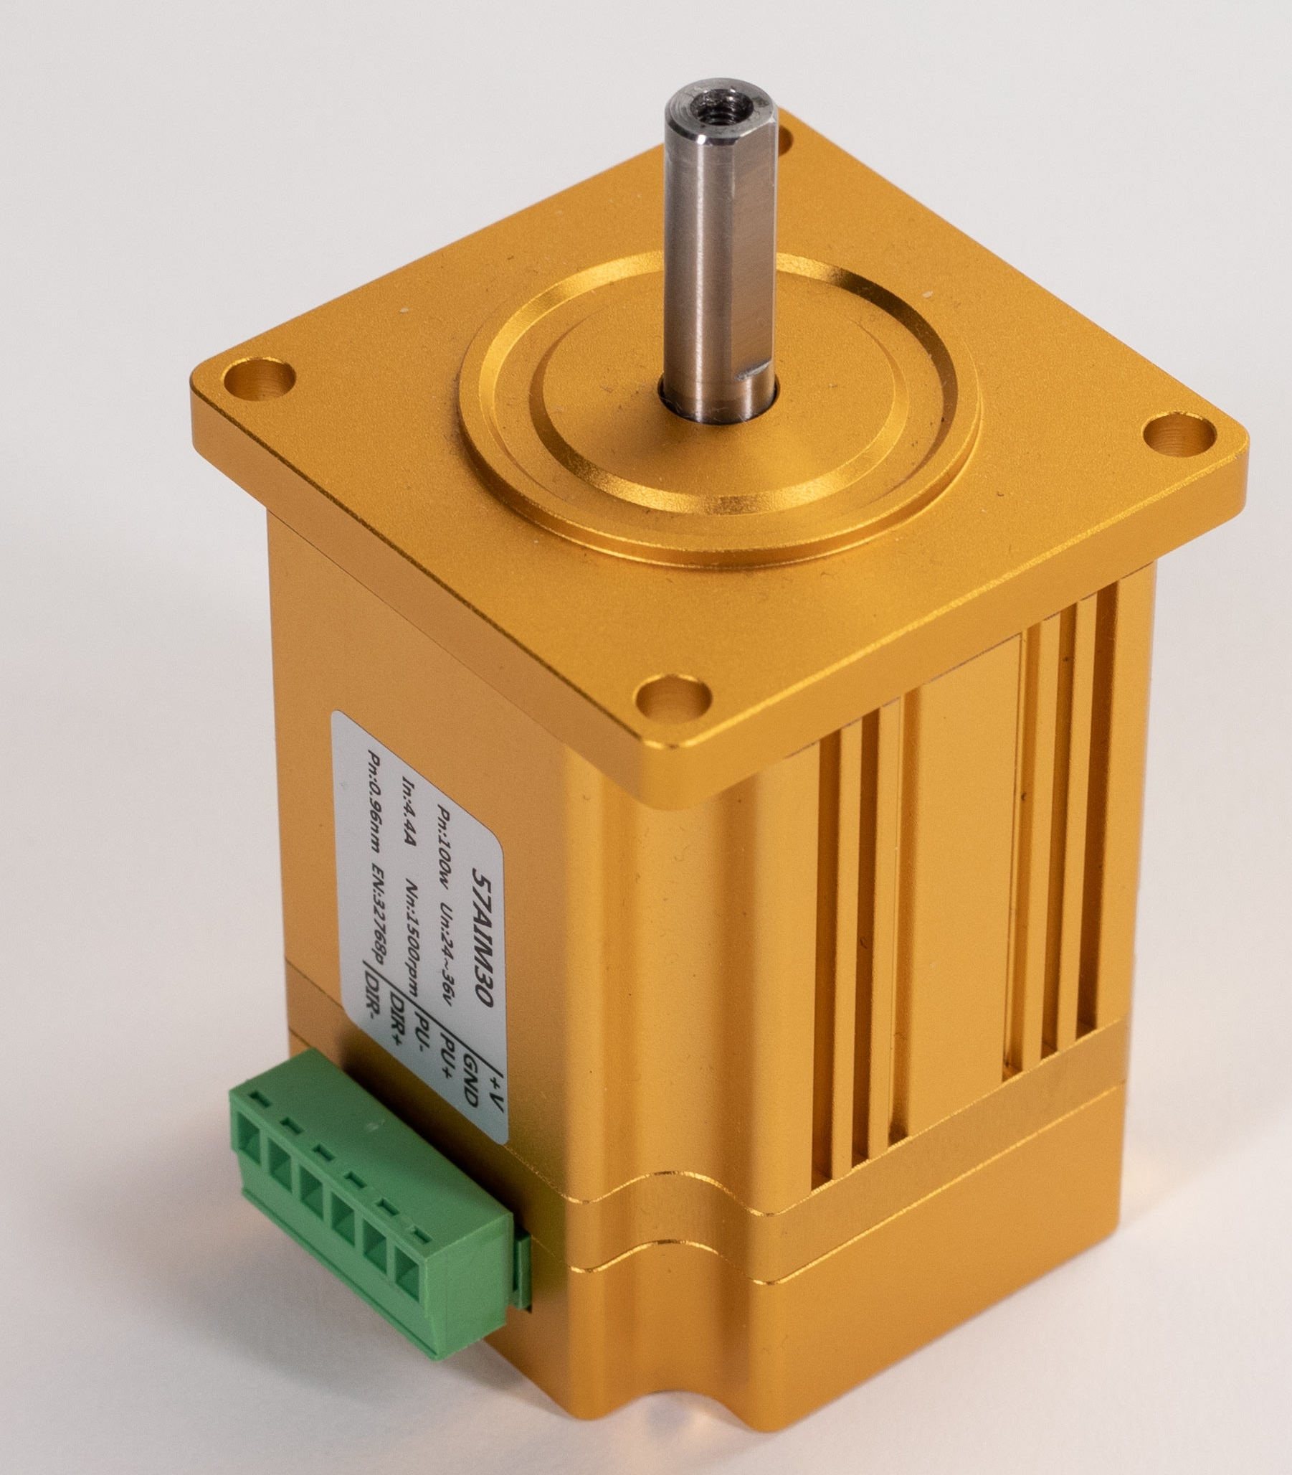
Build it or buy it
OPTION | COST
Wired, Prebuilt | $692
Wireless, Prebuilt | $840
Kit, Wired | $579
Kit, Wireless | $692
Main Components, Build Yourself | Motor (100W) $150 + Electronics Kit $60 + Power Supply (~$30) + Mount Rails ($45) = $285 I did it for less! You can tell!
The “Main Motor” has changed since my build – smaller, lighter, more torque at the cost of less speed (but don’t worry)

Slide 11
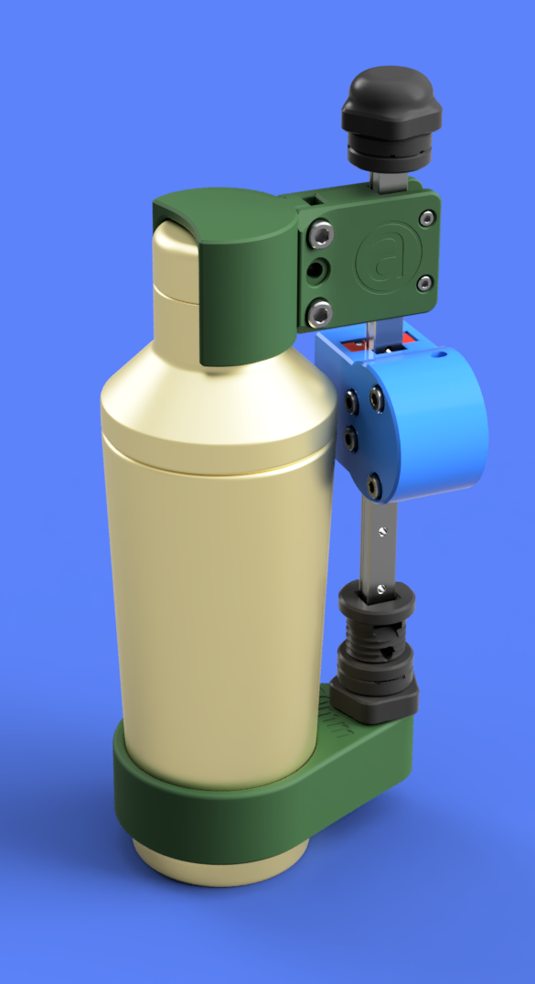
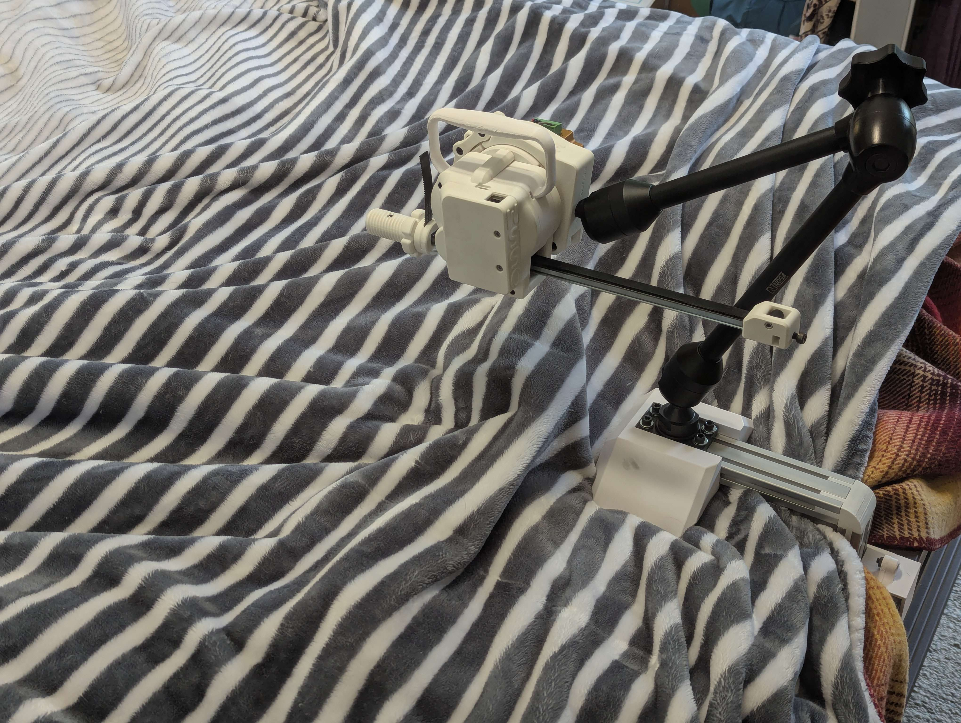
Community Support and Many modifications
All open source on github
  make it all 100% yourself if you want
Video assembly tutorials
Written documentation
Active discord (both ossm project and kinky makers umbrella)
So much tinkering possible
  Machinable base!
  CAD (though I don’t know how fusion does things)
Image sources: Kinky Makers Discord ossm-print-testing

